Slide 1
Types of databases

Slide 2
Agenda
Relational database.
Cloud database.
Object-oriented database.
Centralized database.
NoSQL database.
Personal database.
Operational database.
Graph databases.

Slide 3
Relational Database
Most commonly used database.
Contains a number of tables and each table has its primary key.
Database relationships in the form of tables.
Data is stored in the form of tables that contains rows and columns.

Slide 4
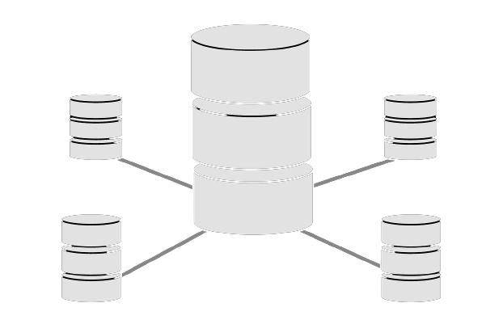
Relational Database
Include SQL, MS SQL Server, ORACLE and so on.
Form of tables it is the reason we can access our data easily.

Slide 5

Cloud Database
A hybrid cloud, or a private cloud are referred as virtual environments.
Pay for storage capacity and bandwidth.
It also provides on-demand scalability and high availability.

Slide 6
Object-oriented database
Store any type of data.
Represented and stored in the form of objects.
Objects are used to store the data.
The attributes and methods of the objects to be stored in the database.
Example:
PostgreSQL.

Slide 7
Centralized Database
Users from different places can access the data because it is stored centrally.
Allow users to access the data even from a remote place.

Slide 8
NoSQL database
NoSQL database design allows configurable schemas for data storage and retrieval.
To store massive amounts of data.
By relational databases, and NoSQL systems can readily address such issues.

Slide 9
Personal Database
Small, easily controllable personal computers are used to collect and store data.
By the same firm department and only a few people have access to it.

Slide 10
Operational Database
Information about a company's operations is stored in this database.
For a variety of functions, including marketing, employee relations, customer service, and so on.

Slide 11
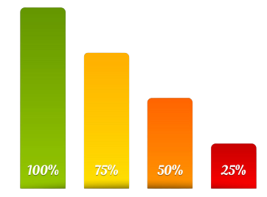
Graph database
To store, map, and query relationships in a graph-oriented database.
Interconnection analysis is the most common usage for these types of computer databases.
For example: A supermarket can use it to observe and analyse sales of a particular month.

